Slide 1
Leftist Heaps & Skew Heaps
☞ Declaration:
Step 1:
Merge( H₁->Right, H₂ )
6
struct TreeNode
{
ElementType Element;
PriorityQueue Left;
PriorityQueue Right;
int Npl;
} ;
12
7
18
24
8
37
33
17
18
Step 2:
Attach( H₂, H₁->Right )
26
3
☞ Merge (recursive version):
10
6
3
6
21
14
12
7
10
8
12
7
23
18
24
8
37
21
14
17
18
24
37
18
33
17
18
23
26
33
26
Step 3:
Swap(H₁->Right, H₁->Left )
if necessary
H₁
H₂

Slide 2
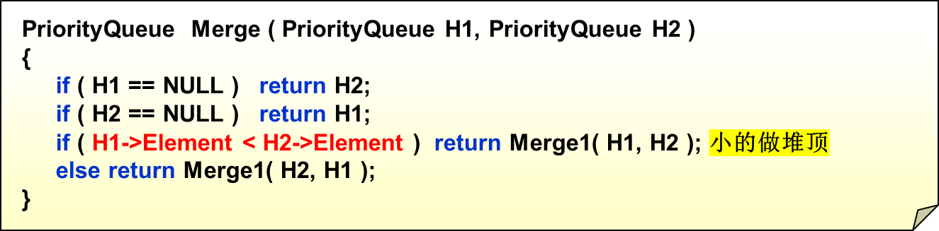
Leftist Heaps & Skew Heaps
static PriorityQueue
Merge1( PriorityQueue H1, PriorityQueue H2 )
{
if ( H1->Left == NULL ) /* single node */
H1->Left = H2; /* H1左是空说明右也空，直接插左一定没错*/
else {
H1->Right = Merge( H1->Right, H2 ); /* Step 1 & 2 */
if ( H1->Left->Npl < H1->Right->Npl )
SwapChildren( H1 ); /* Step 3 */
H1->Npl = H1->Right->Npl + 1; /* 因为递归了，所以刷新一下 */
} /* end else */
return H1;
}
T_{p} = O(log N)

